Slide 1
MongoDB Europe 2016
By Atanas Kuzmanov, CPS, BBC

Slide 2
Resilient MongoDB Applications
The goal:
Execute operations resiliently.
The challenges:
Things that can go wrong.

Slide 3
Resilient MongoDB Applications
How to use “updateOne” resiliently?
A counter is incremented in a document, whose id is a date.
“upsert” is set to true in order to create the document if one does not exist in first place.
updateOne({'_id': '2016-06-28'},
{'$inc': {'counter': 1}},
upsert=True)

Slide 4
Resilient MongoDB Applications
Transient network errors
updateOne message is sent, but the MongoDB driver experiences a network blip.
Driver sees a network layer error. It doesn’t know whether the server received the message or not.
We don’t know if the counter has been incremented.
MongoDB
updateOne
Error

Slide 5
Resilient MongoDB Applications
Persistent errors
A lasting network outage.
Driver sees a network layer error. It doesn’t know whether the server received the message or not.
Retrying the operation will only get more network errors.
MongoDB
updateOne
Error

Slide 6
Resilient MongoDB Applications
Command errors
The driver might receive a specific error message.
Command could not be executed.
Malformed.
Insufficient permissions.
Server out of disk space.
MongoDB
updateOne
{ErrorMsg: “Not authorised”}

Slide 7
Resilient MongoDB Applications
How do MongoDB drivers handle errors?
MongoDB has the “Server Discovery and Monitoring Spec” which requires the driver to track the state of each server.
A 3-node replica set might have a “topology description” like this:
Server 1: Primary
Server 2: Secondary
Server 3: Secondary
If there is a network error talking to a server, it’s type is set to “Unknown” and an exception is thrown. Now the topology description will look like this:
Server 1: UNKNOWN
Server 2: Secondary
Server 3: Secondary
The “updateOne” operation is not retried automatically.
The next command is blocked until it finds the primary.
The driver checks each server twice per second up to 30 seconds, until it rediscovers the primary or becomes aware a new primary has been elected.
After the 30 seconds the driver throws a “server selection timout” exception.

Slide 8
Resilient MongoDB Applications
Bad retry strategies

Slide 9
Resilient MongoDB Applications
Don’t retry strategy
Transient network blip
We don’t know if the server has received the message.
If the message is lost the count is not increased.
Persistent network outage
The “Don’t retry” strategy is correct as more attempts are fruitless.
Command error
The “Don’t retry” strategy is correct as more attempts are fruitless.
Strategy not suitable for all cases.
Network blip | Persistent network outage | Command error
May undercount | Correct | Correct

Slide 10
Resilient MongoDB Applications
Always retry strategy
[MAX_RETRY_COUNT]
Transient network blip
We don’t know if the server has received the message.
If the confirmation message from the server is lost the next retry will increase the count again.
Persistent network outage
Wastes time.
If the primary is marked as “unknown”, all subsequent retries will be blocked until the driver attempts to reconnect.
Command error
The same case as for “Persistent network outage”.
Strategy not suitable for any cases.
Network blip | Persistent network outage | Command error
May overcount | Wastes time | Wastes time

Slide 11
Resilient MongoDB Applications
Retry errors once strategy
Transient network blip
We don’t know if the server has received the message.
If the confirmation message from the server is lost the next retry will increase the count again.
Persistent network outage
One retry will enter the 30 second driver retry loop.
If the problem does not go away after 30 seconds it’s likely a more persistent outage and more attempts would not be profitable.
Command error
One retry will enter the 30 second driver retry loop.
If the problem does not go away after 30 seconds it’s likely a more serious problem that will not go away by retrying.
Strategy not suitable for all cases.
Network blip | Persistent network outage | Command error
May overcount | Correct | Correct

Slide 12
Resilient MongoDB Applications
Solution:
Make operations idempotent.

Slide 13
Resilient MongoDB Applications
What does idempotent mean?!?!
Idempotent operations are those which can be applied multiple times without changing the result beyond their initial application.

Slide 14
Resilient MongoDB Applications
Find
Queries are naturally idempotent.
There is no harm in retrieving a document twice.
try:
doc = findOne()
except network err:
doc = findOne()

Slide 15
Resilient MongoDB Applications
Insert
Not as easy as queries.
Generate unique id client side (MongoDB ObjectIds).
Scenario:
Try 1: fail with network error
Try 2:
If it fails with a duplicate id (key) error from the server, then Try 1 has succeeded.
doc = {_id: ObjectId(), ...}
try:
insertOne(doc)
except network err:
try:
insertOne(doc)
except DuplicateKeyError:
pass # first try worked
throw

Slide 16
Resilient MongoDB Applications
Delete
If a document is deleted using a unique value for the key, then there is no harm in doing it twice.
If the first delete has succeeded the second one will not match any documents.
Deleting one document:
Deleting multiple documents with a filter:
try:
deleteOne({'key': uniqueValue})
except network err:
deleteOne({'key': uniqueValue})
try:
deleteMany({...})
except network err:
deleteMany({...})

Slide 17
Resilient MongoDB Applications
Update
Updates which use $set are naturally idempotent.
Setting “sunny” to “true” twice is just as good as setting it once.
In this case updateOne is safe to retry.
# Idempotent update.
updateOne({ '_id': '2016-06-28'},
{'$set':{'sunny': True}},
upsert=True)

Slide 18
Resilient MongoDB Applications
Update
Updates which use $inc are not idempotent.
Using this operation twice will increment the counter by 2.
In this case updateOne is not safe to retry.
# Non-idempotent update.
updateOne({ '_id': '2016-06-28'},
{'$inc': {'counter': 1}},
upsert=True)

Slide 19
Resilient MongoDB Applications
Update
How to make update an idempotent operation?!?!?!
Split it into two steps
Each of them will be idempotent.
A pair of idempotent operations will be safe to retry.

Slide 20
Resilient MongoDB Applications
Document counter is N
Step 1
Add a token to a “pending” array.
Something unique such as an ObjectId.
{
_id: '2016-06-28',
counter: N
}
oid = ObjectId()
try:
updateOne({ '_id': '2016-06-28'},
{'$addToSet': {'pending': oid}},
upsert=True)
except network err:
try again, then throw

Slide 21
Resilient MongoDB Applications
$addToSet is one of the idempotent operators.
Even if executed twice, the token is added only once to the array.
The document after Step 1:
{
_id: '2016-06-28',
counter: N,
pending: [ ObjectId("...") ]
}

Slide 22
Resilient MongoDB Applications
Step 2
With a single message the document is queried by its _id and its pending token.
The pending token is deleted.
The counter is incremented.
All MongoDB updates are atomic.
A single “updateOne” will either succeed or have no effect at all.
try:
# Search for the document by _id and pending token.
updateOne({'_id': '2016-06-28',
'pending': oid},
{'$pull': {'pending': oid},
'$inc': {'counter': 1}},
upsert=False)
except network err:
try again, then throw

Slide 23
Resilient MongoDB Applications
This "updateOne" is idempotent.
Scenario:
Try 1
Token is pulled out of the array.
The counter is incremented.
Network fails and server response is not received.
Try 2
The query is looking for a document with the pending token, but doesn't find it.
Noop
Document after idempotent updateOne:
{
_id: '2016-06-28',
counter: N + 1,
pending: [ ]
}

Slide 24
Resilient MongoDB Applications
Caveat 1
The simple increment operation now needs two round trips.
Double the latency.

Slide 25
Resilient MongoDB Applications
If second step never completes?!
Caveat 2
Requires something to clean up unfinished operations.
A separate task, a script or a nightly job.
The document is left like this:
{
_id: '2016-06-28',
counter: N,
pending: [ ObjectId("...") ]
}

Slide 26
Resilient MongoDB Applications
This is a distilled version of the case study, for more details, see A. Jesse Jiryu Davis's blog:
https://emptysqua.re/blog/how-to-write-resilient-mongodb-applications/

Slide 28
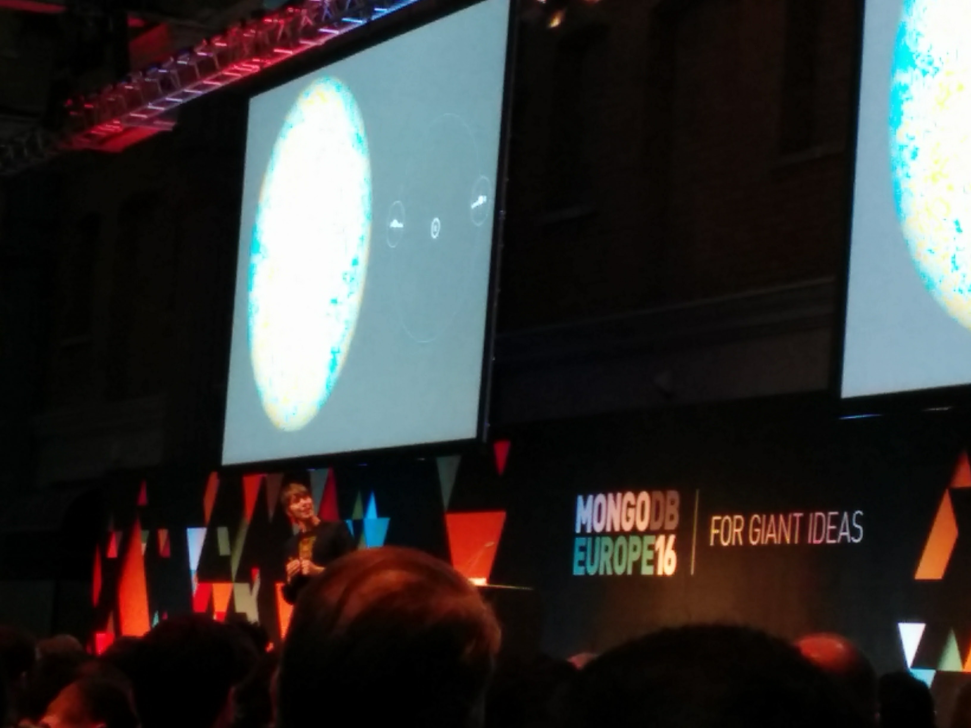
Professor Brian Cox’s Keynote

Slide 29
Professor Brian Cox’s Keynote
"The Ultimate Question of Life, The Universe, and Everything?”
Douglas Adams, "The Hitchhiker's Guide to the Galaxy" (1985)

Slide 30
Professor Brian Cox’s Keynote
Spoiler alert!
42

Slide 31
Professor Brian Cox’s Keynote
Big data on cosmic scale.

Slide 32
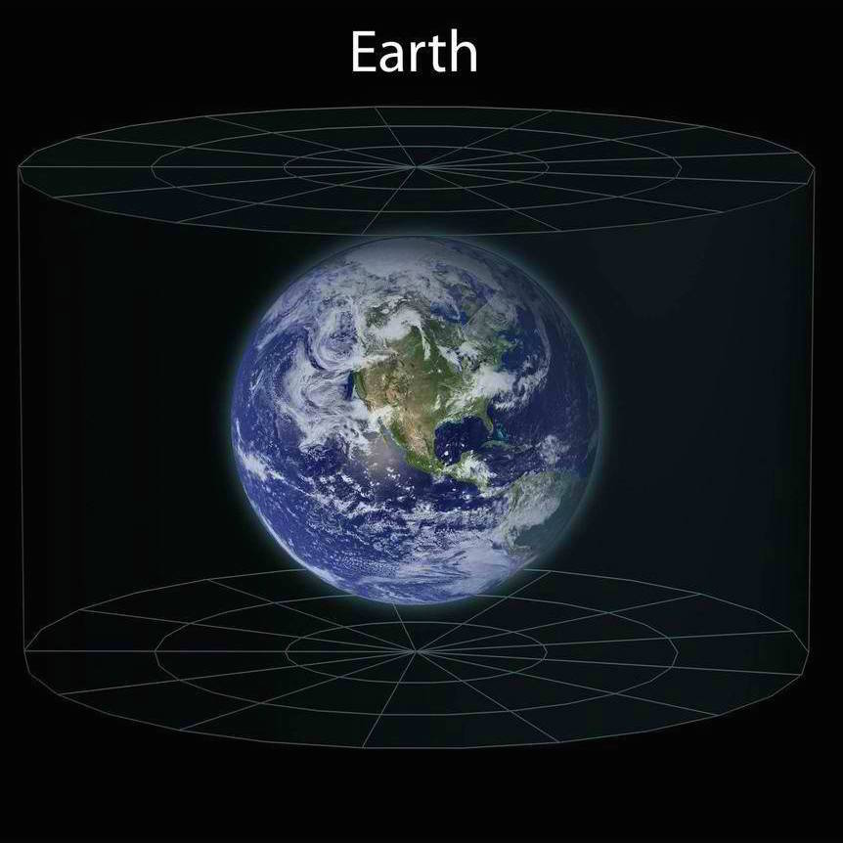
Professor Brian Cox’s Keynote

Slide 33
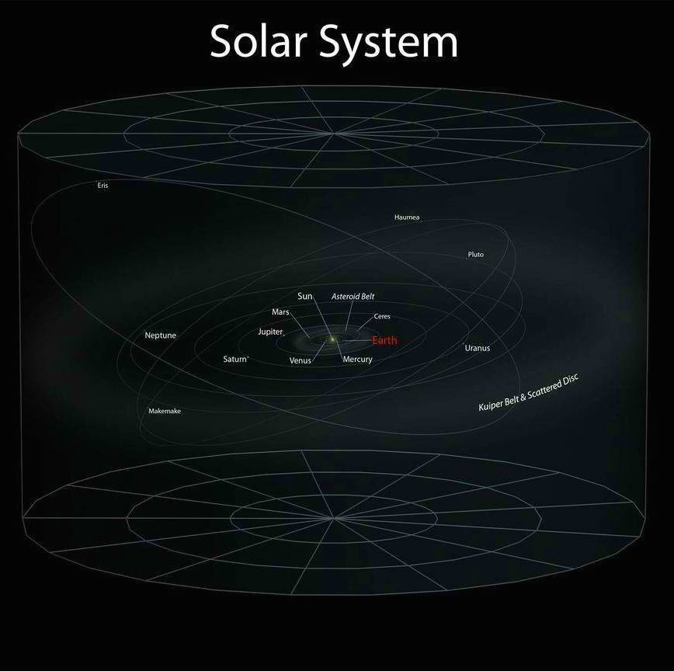
Professor Brian Cox’s Keynote

Slide 34
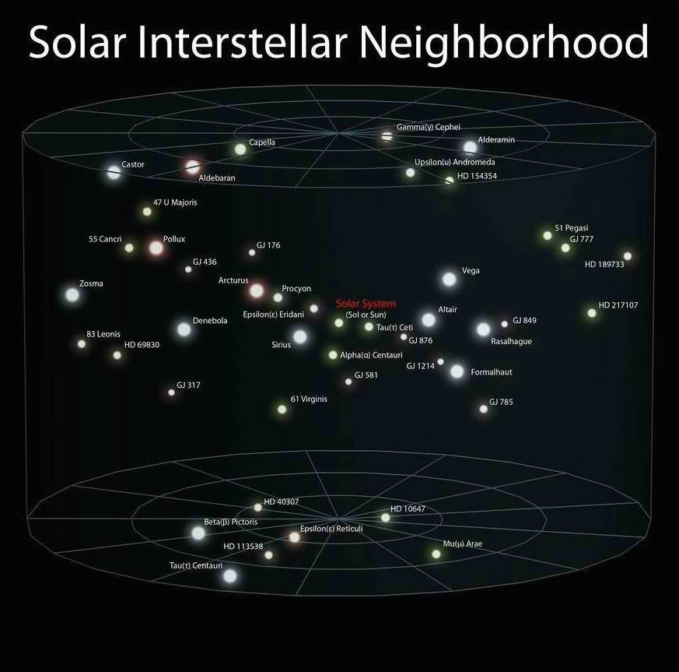
Professor Brian Cox’s Keynote

Slide 35
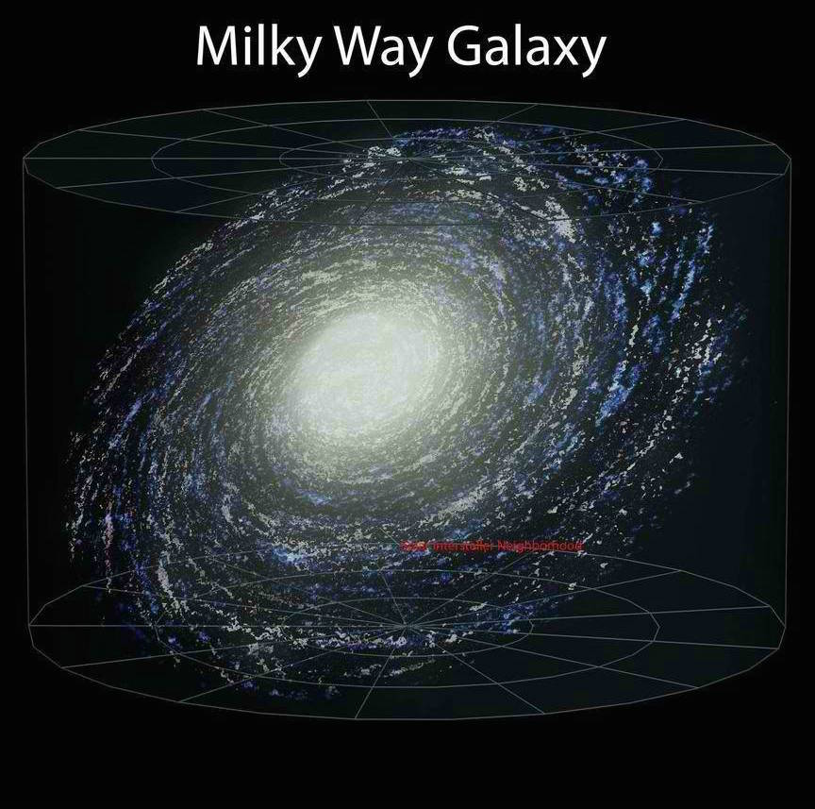
Professor Brian Cox’s Keynote

Slide 36
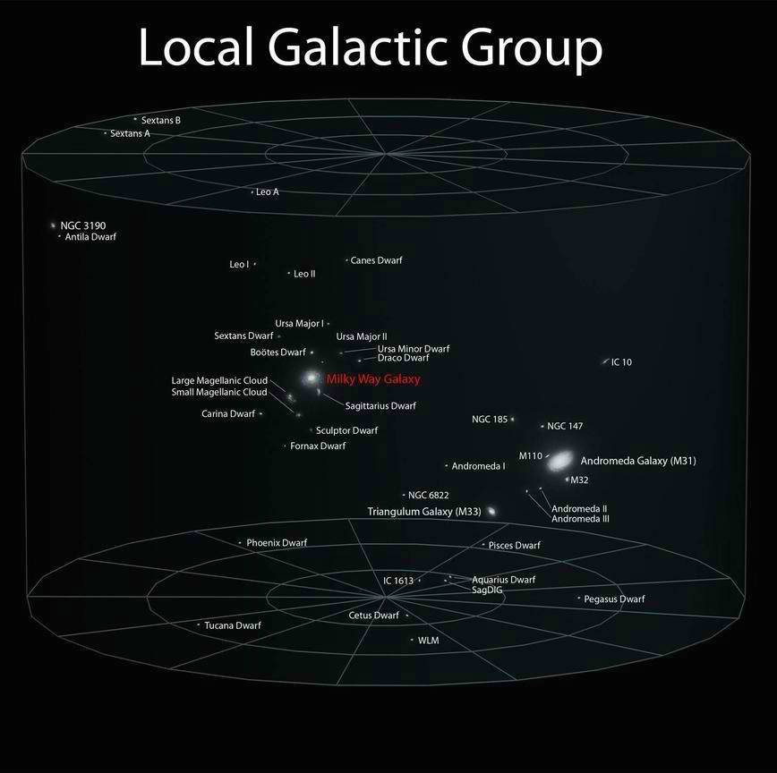
Professor Brian Cox’s Keynote

Slide 37
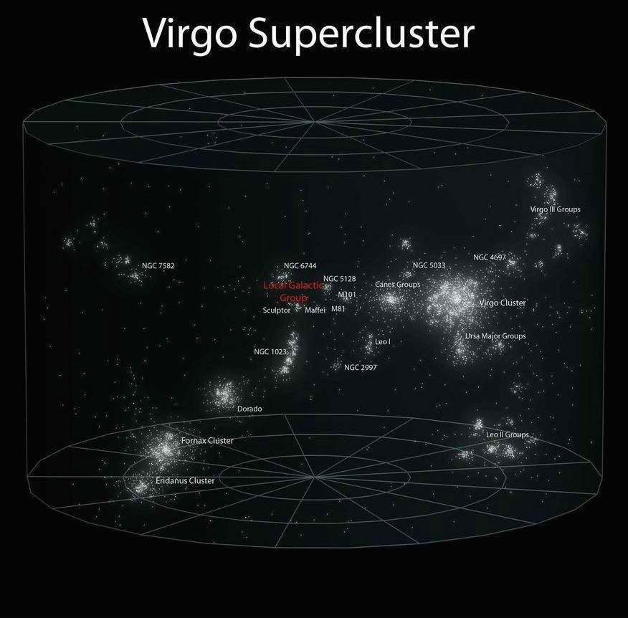
Professor Brian Cox’s Keynote

Slide 38
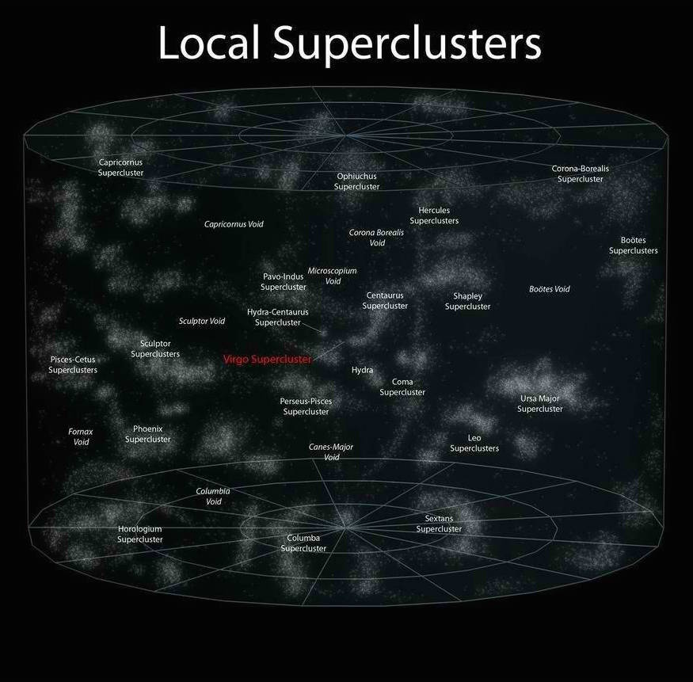
Professor Brian Cox’s Keynote

Slide 39
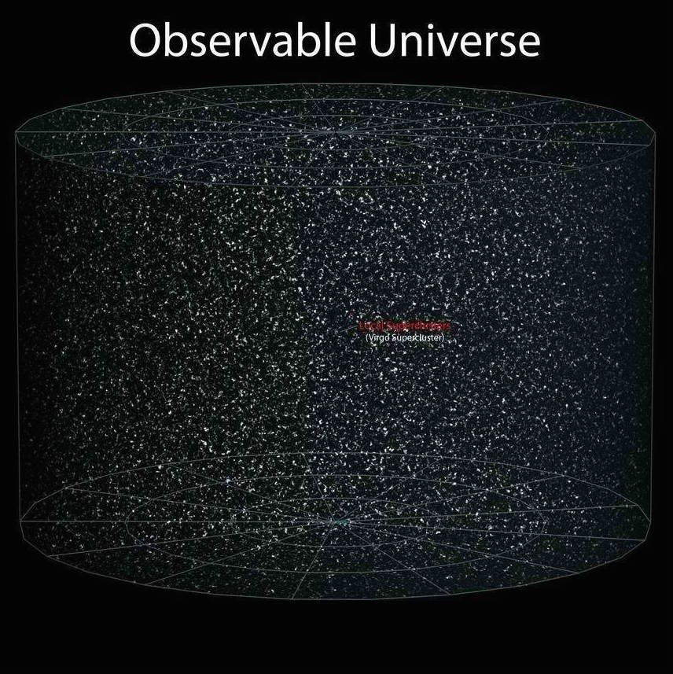
Professor Brian Cox’s Keynote

Slide 40
Professor Brian Cox’s Keynote
BEYOND?!

Slide 41
Professor Brian Cox’s Keynote
?

Slide 42
References
References:
https://emptysqua.re/blog/how-to-write-resilient-mongodb-applications/
https://www.mongodb.com/europe16/schedule
https://github.com/Paul-Ladyman/mongodb-europe-16
https://en.wikipedia.org/wiki/Idempotence
http://i.imgur.com/0fPRk.jpg
https://en.wikipedia.org/wiki/The_Hitchhiker%27s_Guide_to_the_Galaxy

Slide 43
THE END
Thank you!

Slide 44
THE END
Questions?

